Slide 2
2018 IEEE (Hong Kong) EMC Chapter Officers:
Chair: Dr. LEE Kam Chuen, KC BEng (Hons), PhD (Sheffield U, UK), CEng, MIET, MIEEE kclee@stc.group
General Manager – Hong Kong Standards and Testing Centre (STC)
Vice-Chair: Mr. CHAN Chi Fung, George Georgecfchan@yahoo.com.hk
Product Safety Engineer - ASM Pacific Technology
Secretary: Mr. TANG Chi Kit, Jacky cityjacky001@yahoo.com.hk
Electronics Engineer - Electrical and Mechanical Services Department (EMSD)
The Government of HKSAR
Treasurer: Mr. CHAN Chi Fung, George Georgecfchan@yahoo.com.hk

Slide 3
The IEEE Hong Kong EMC Society Chapter, as a supporting organization, organized a seminar titled “Certification and Testing of Electronic Products for China (CCC Mark) & International Markets” in the Hong Kong Electronics Fair (Spring Edition) held at the Hong Kong Convention and Exhibition Centre. The speaker of the seminar was our IEEE Hong Kong EMC Society Chapter Chair 2018, Dr. LEE Kam Chuen from the Hong Kong Standards and Testing Centre (STC), and the seminar introduced the regulatory and certification requirements of consumer electronic products in China and global markets, China Compulsory Certification Mark (CCC Mark), and global one-stop certification service. The seminar aimed at promoting local testing and certification service to local and international buyers and positive feedback was received.
2018 IEEE(HK) EMC Chapter Activities (1/2) :
The Hong Kong Electronics Fair (Spring Edition), 13-16 April 2018

Slide 4
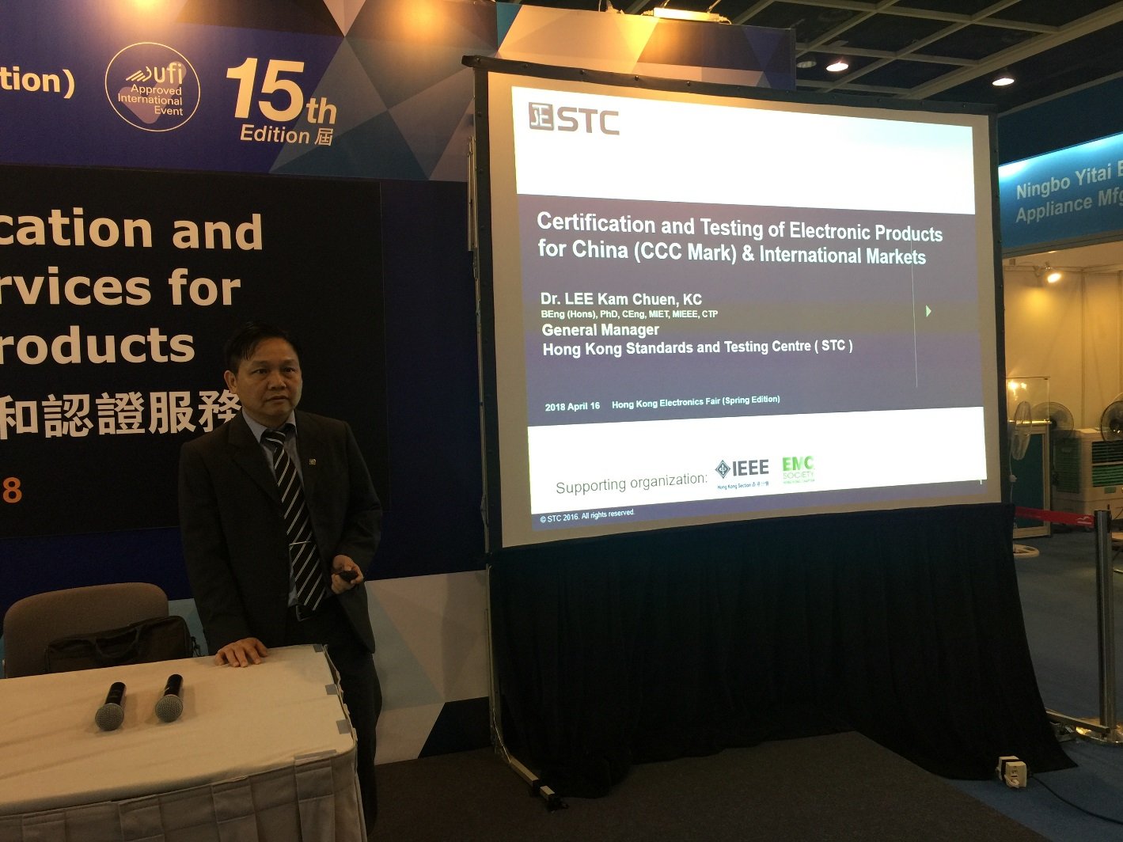
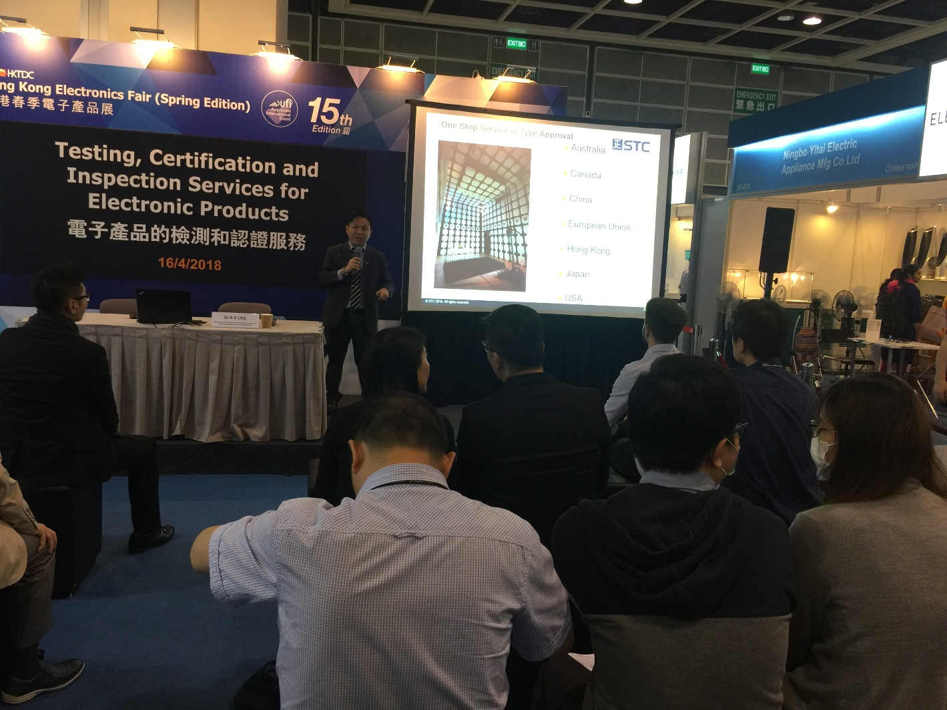
2018 IEEE(HK) EMC Chapter Activities (1/2) :
Dr. LEE Kam Chuen, EMC (HK) Chapter Chair, presented a seminar on “Certification and Testing of Electronic Products for China (CCC Mark) & International Markets”

Slide 5
2018 IEEE(HK) EMC Chapter Activities (2/2) :
Co-organizer for this event

Slide 6
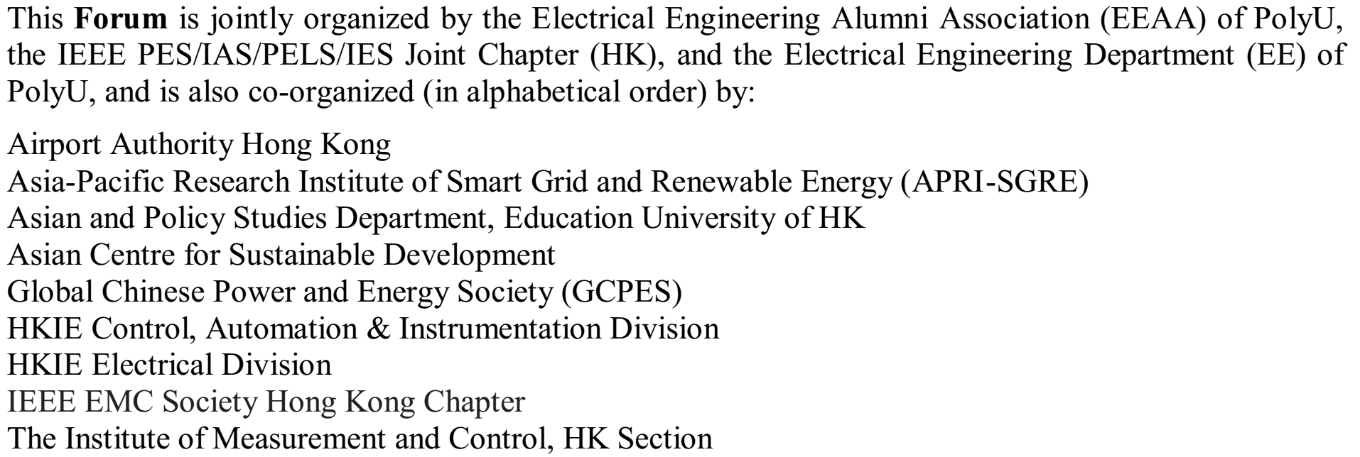
2018 IEEE(HK) EMC Chapter Activities (2/2) :

Slide 7
How many members are in your chapter?
Active members: 27
What do you think you are doing right?
Expose the EMC Chapter more by
Arranging technical seminars
Having cooperation with other organizations/societies for seminars, forums and etc.
Where do you think your chapter needs help?
Hiccups in IEEE (HK) Section, claiming event expenses…
Thank You !
Dr. LEE Kam Chuen, KC BEng (Hons), PhD (Sheffield U, UK), CEng, MIET, MIEEE, CTP General Manager, Electrical Products Hong Kong Standards and Testing Centre ( STC ) Direct Tel (HK): +852 2666 1852 Email: kclee@stc.group

